Slide 1
AB JEWELL HMI currently
Tulsa AB Jewell Water Treatment Facility HMI as of 6-2014
By Scott Graham

Slide 2
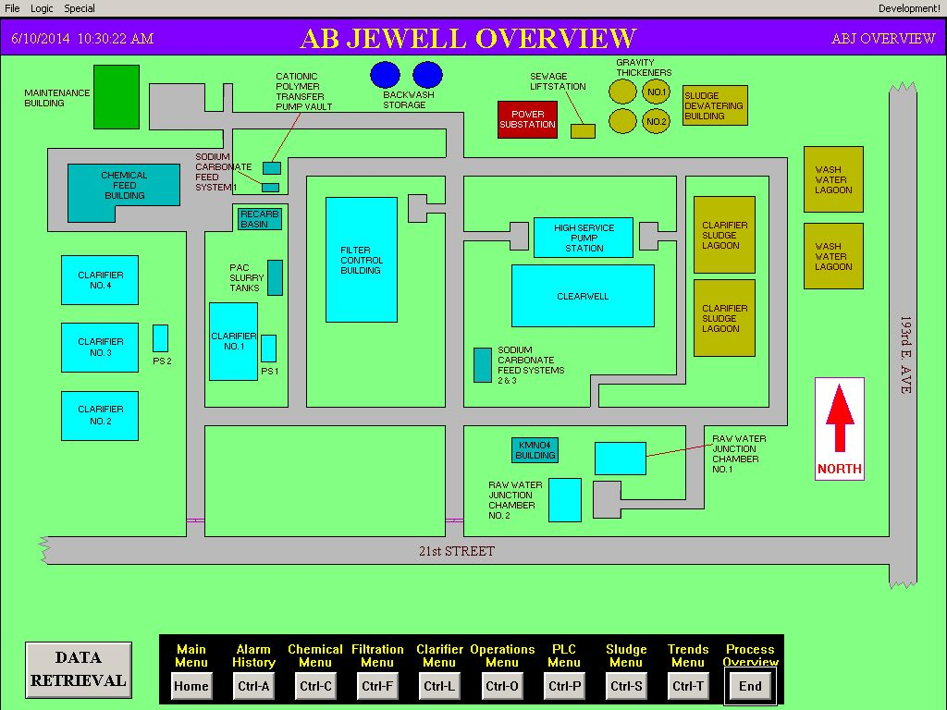
PLANT OVERVIEW PHYSICAL LOCATION

Slide 3
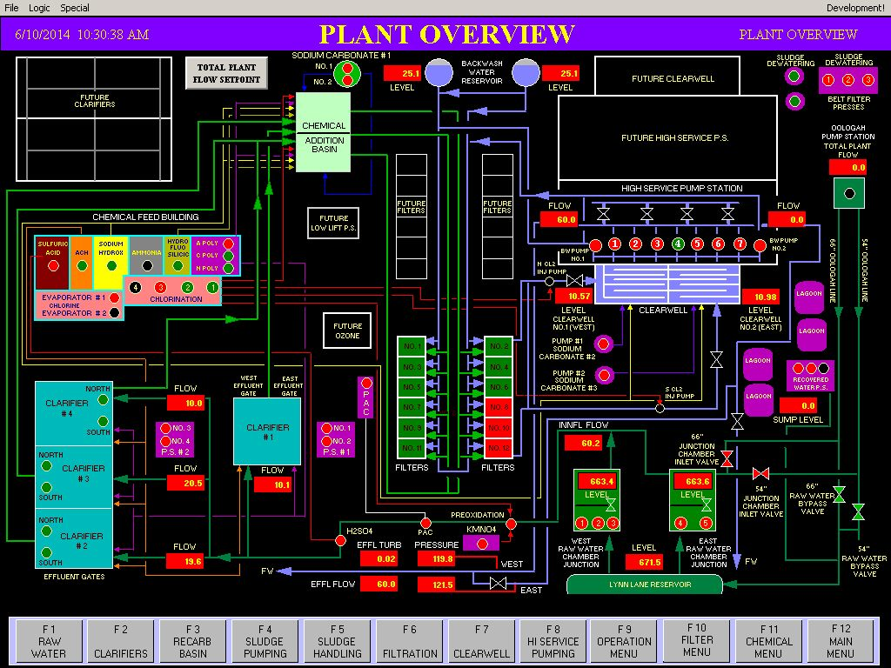
PLANT OVERVIEW BY PROCESS

Slide 4
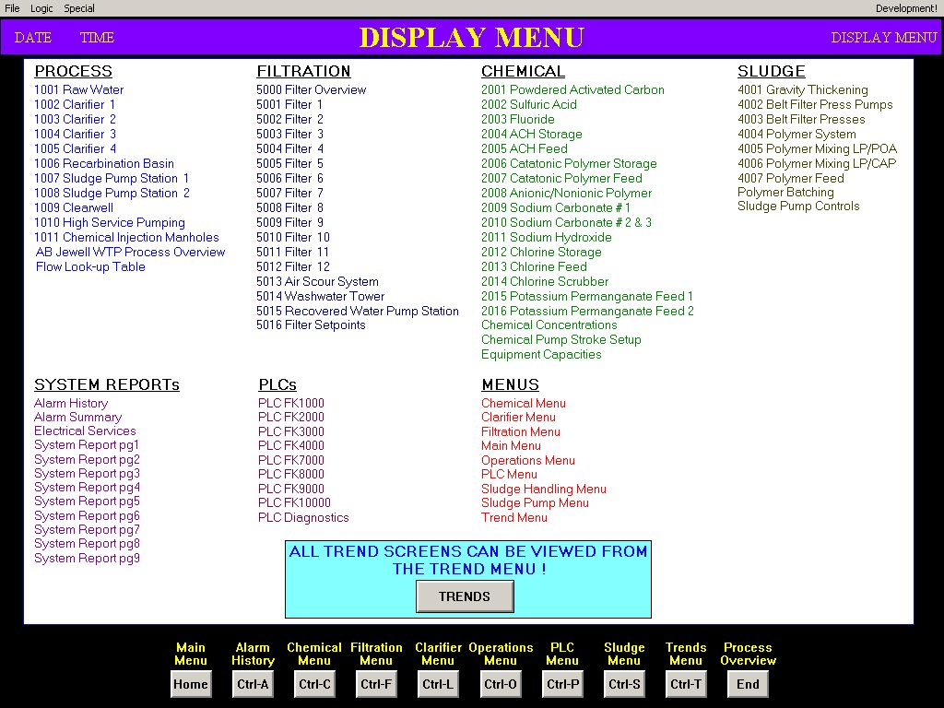
DISPLAY MENU

Slide 5
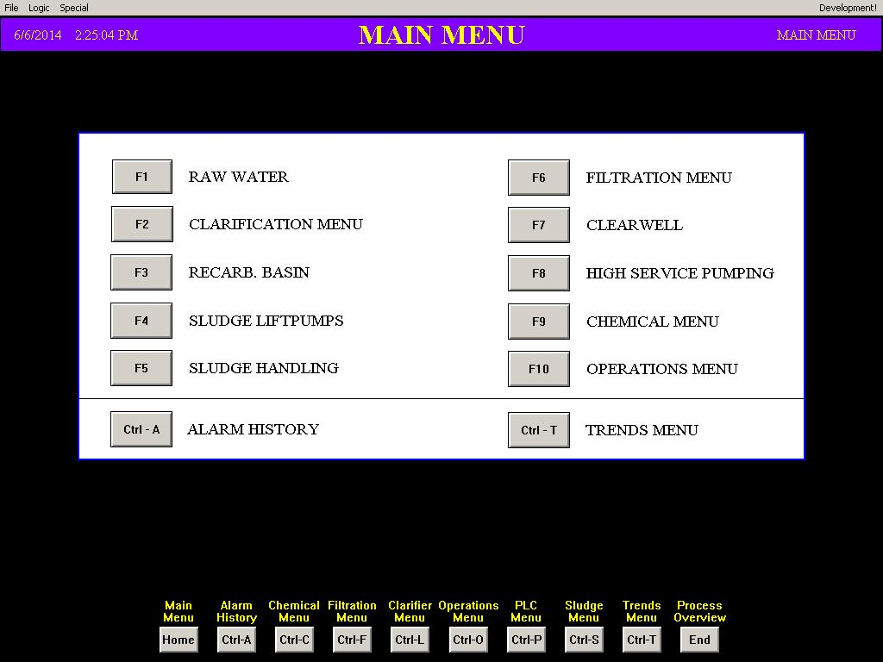
MAIN OPERATIONAL MENU

Slide 6
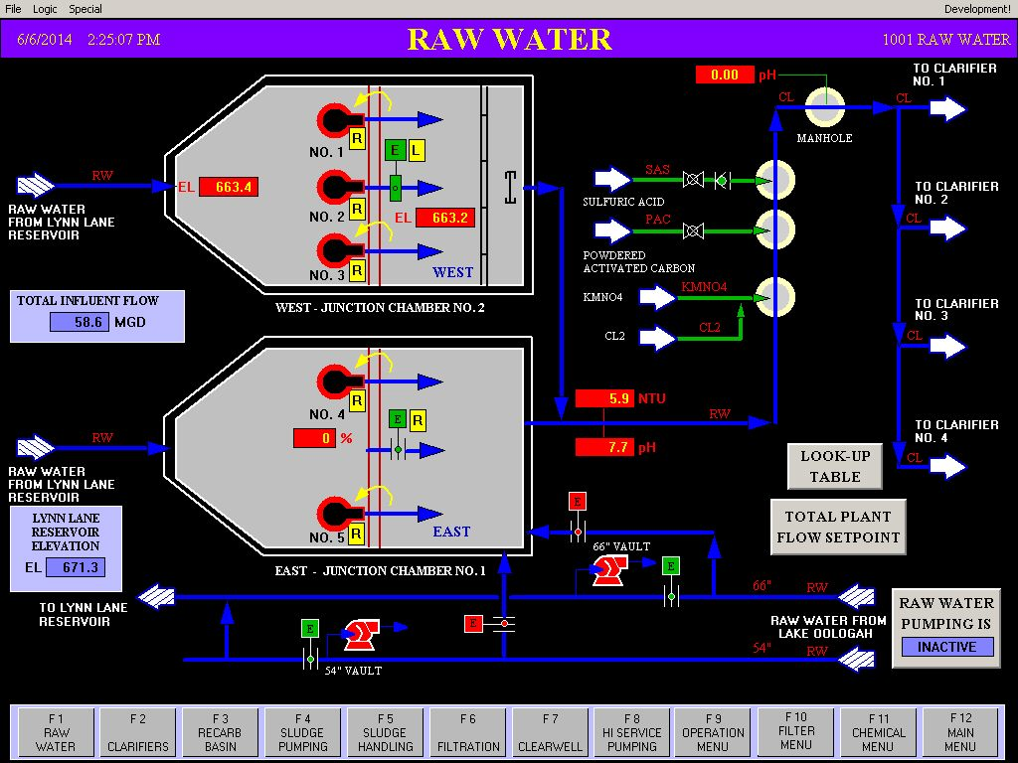
Raw Water

Slide 7
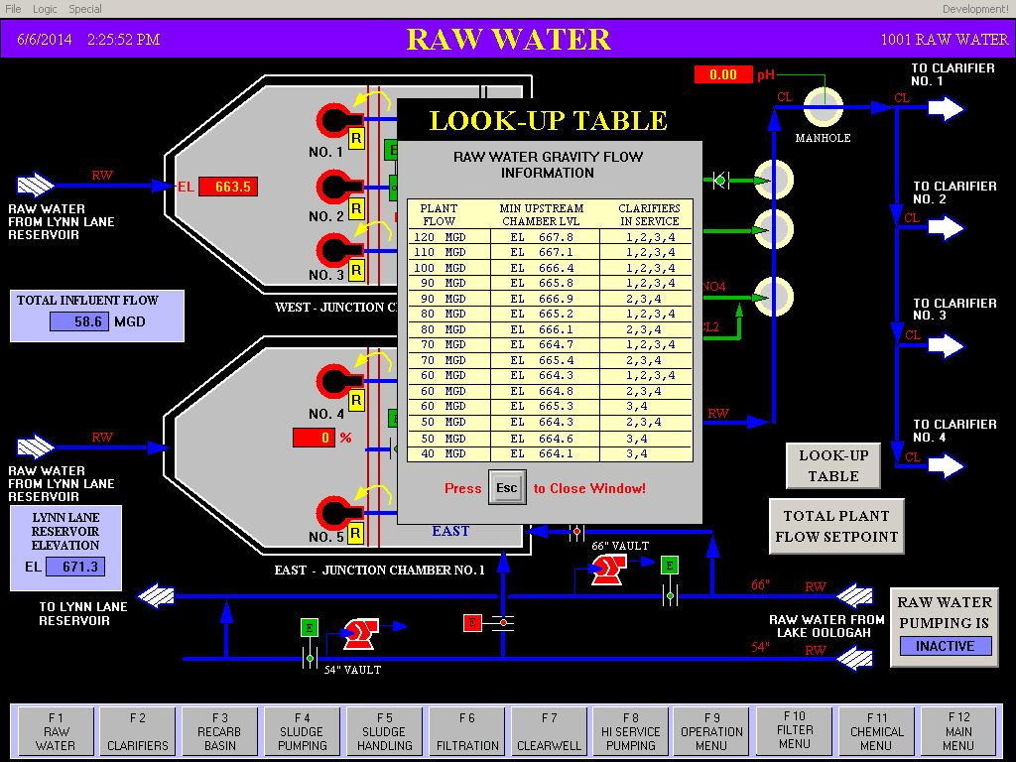
CLARIFIER LOOK-UP TABLE

Slide 8
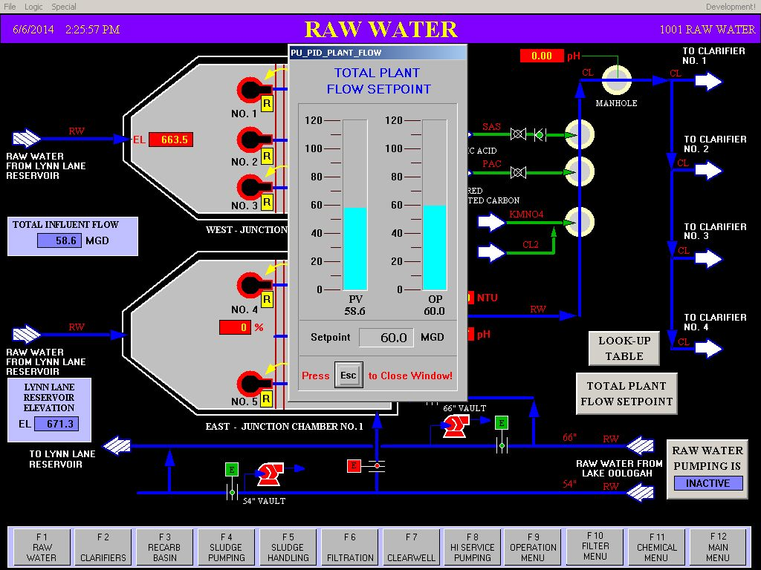
FLOW SETPOINT INPUT

Slide 9
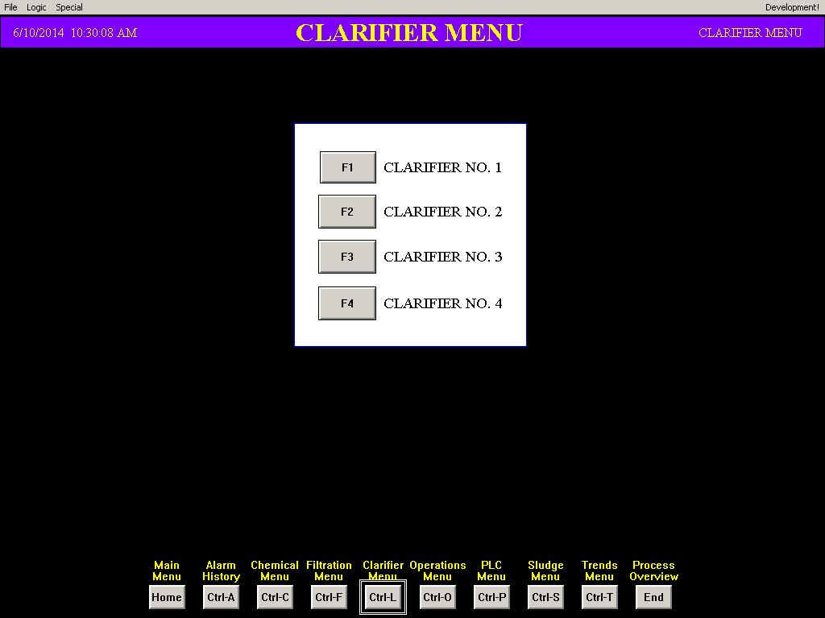
CLARIFIER MENU

Slide 10
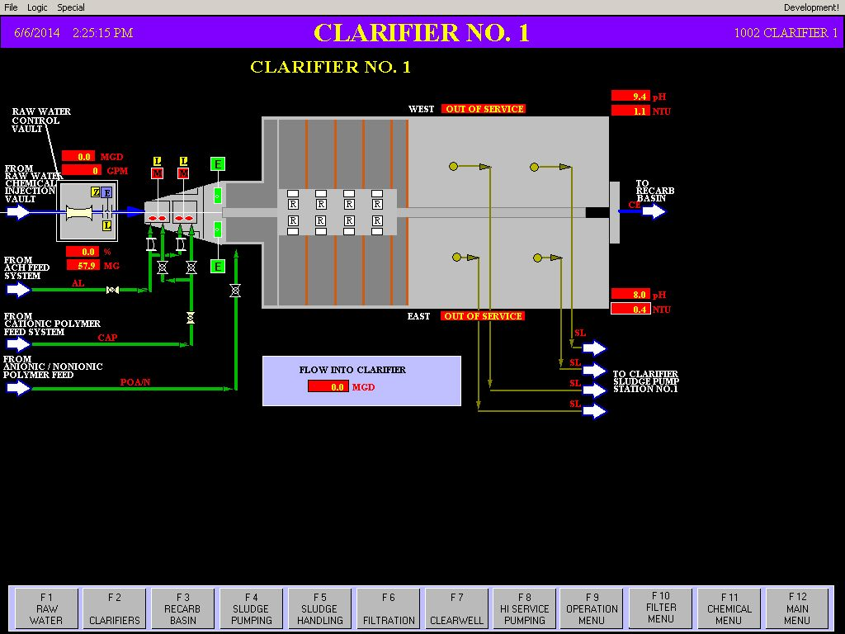
CLARIFIER 1

Slide 11
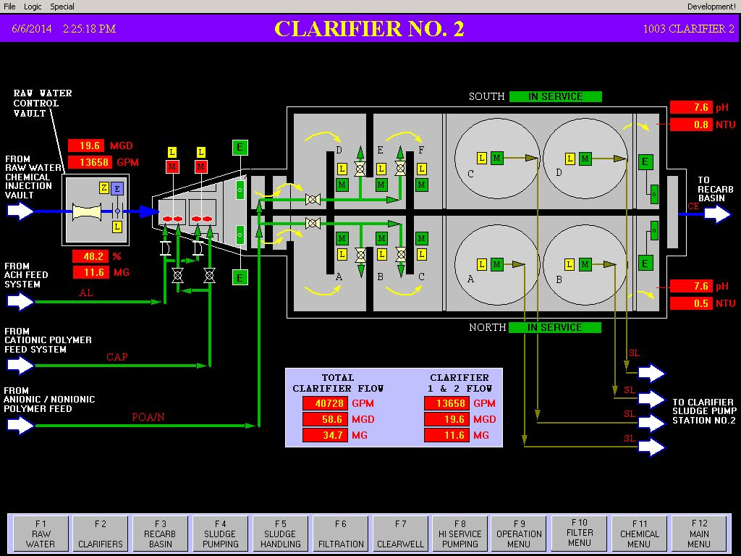
CLARIFIER 2

Slide 12

CLARIFIER 3

Slide 13
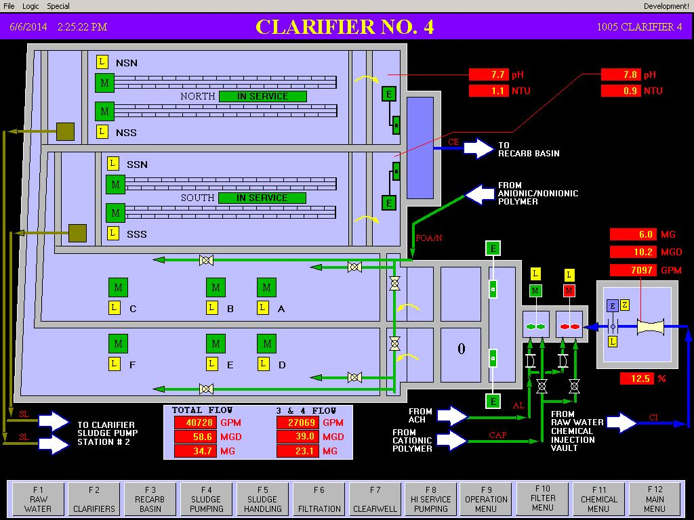
CLARIFIER 4

Slide 14
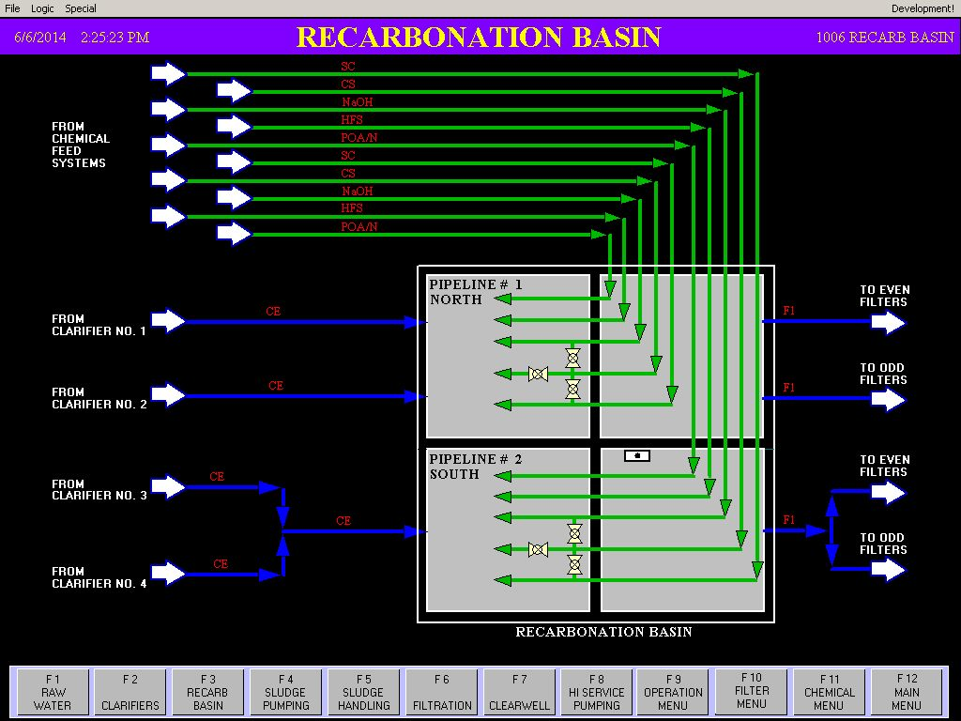
RECARB BASIN

Slide 15
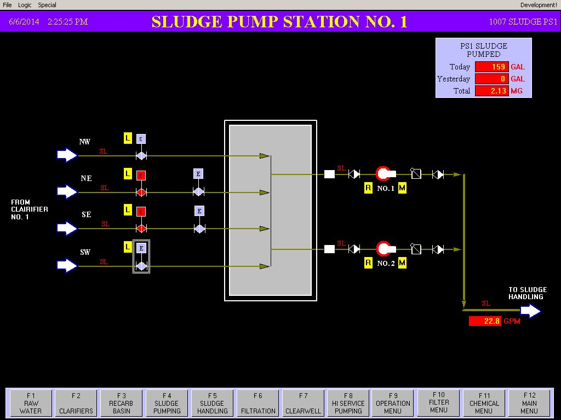
SLUDGE PUMP STATION 1

Slide 16
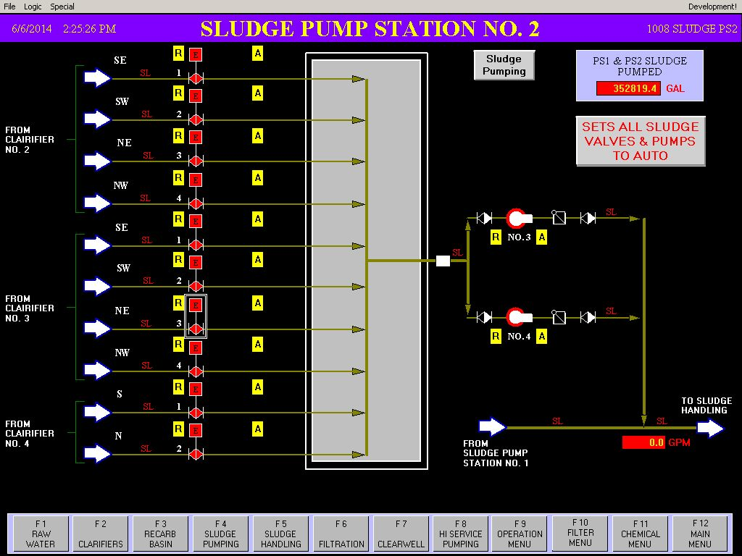
SLUDGE PUMP STATION 2

Slide 17
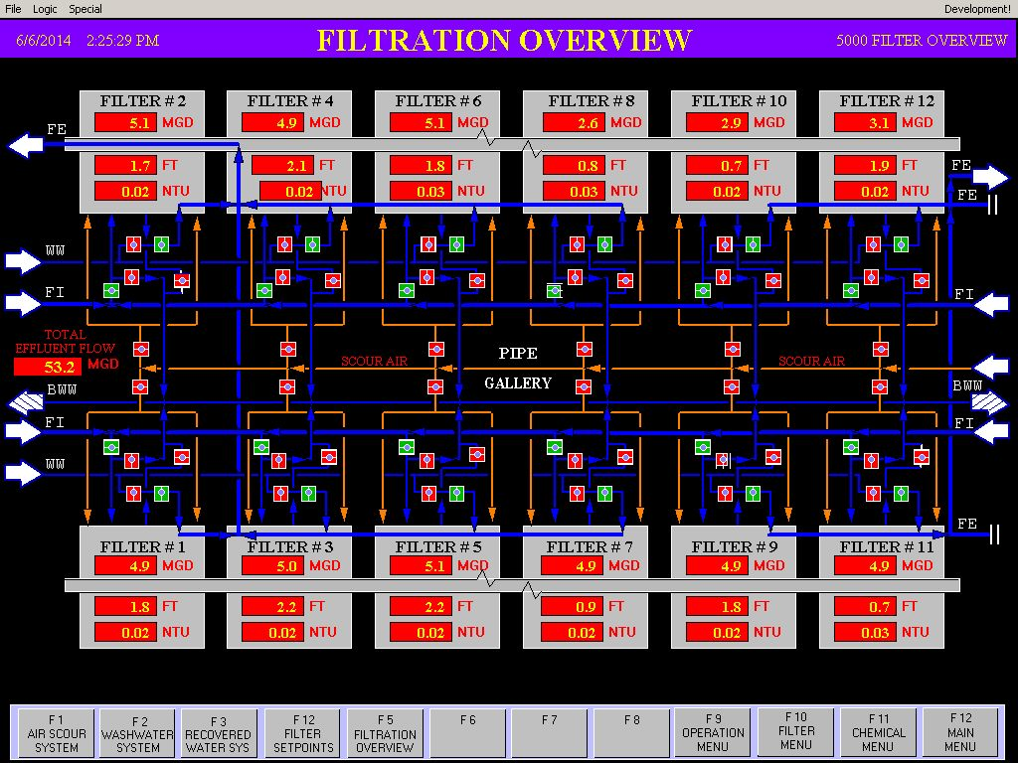
FILTER OVERVIEW

Slide 18
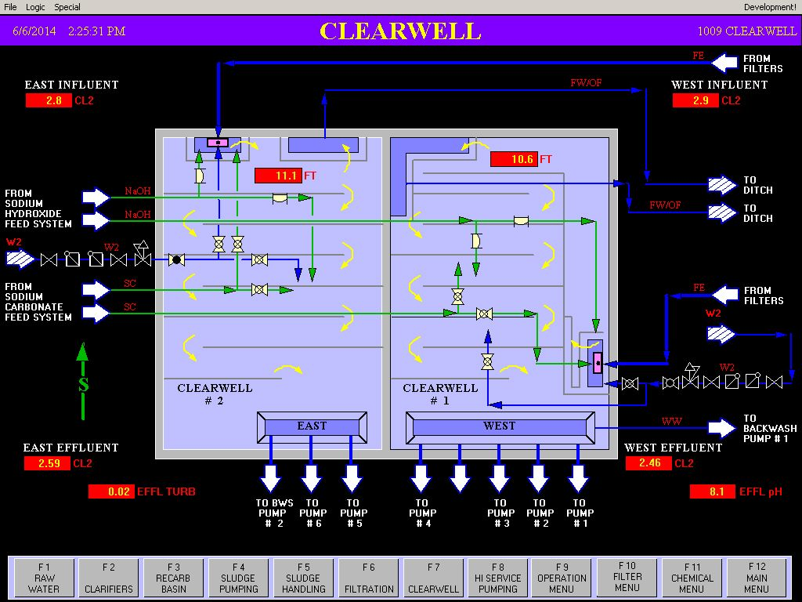
CLEARWELL

Slide 19
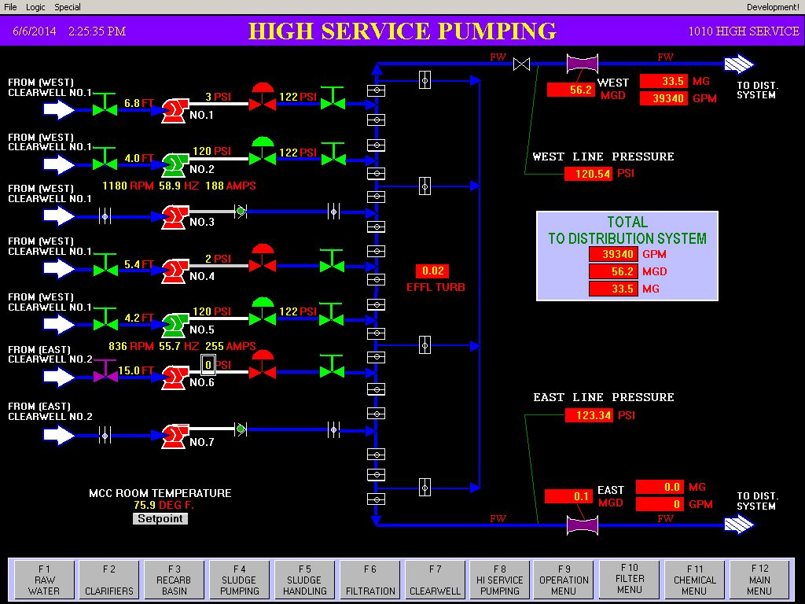
HIGH SERVICE (original)

Slide 20
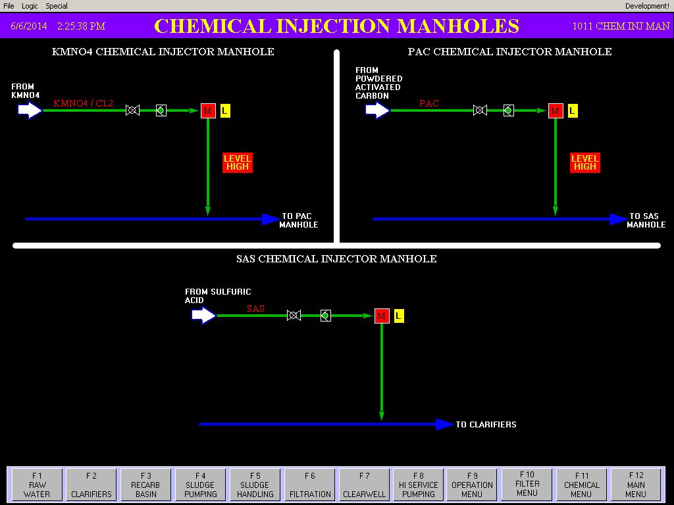
CHEMICAL INJECTION MANHOLES

Slide 21
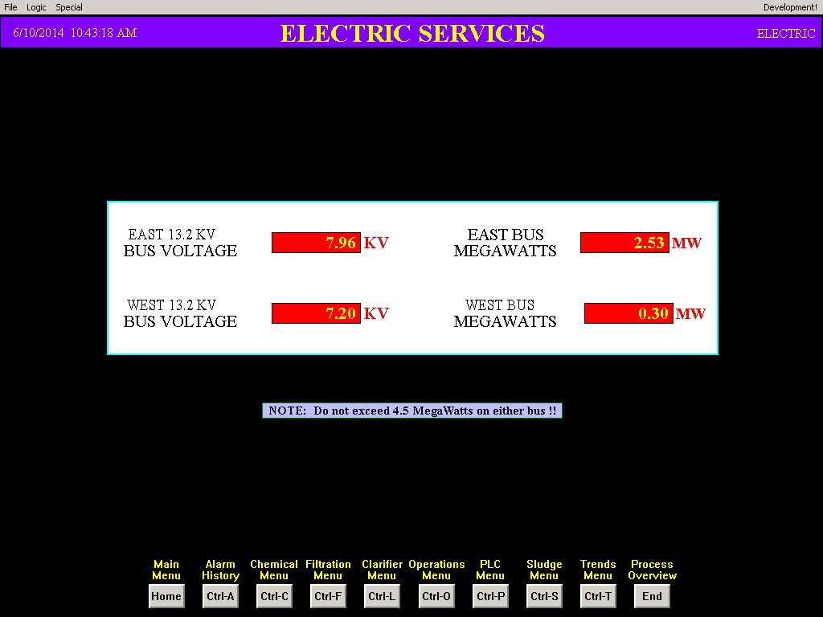
ELECTRIC VOLTAGE & WATTAGE

Slide 22
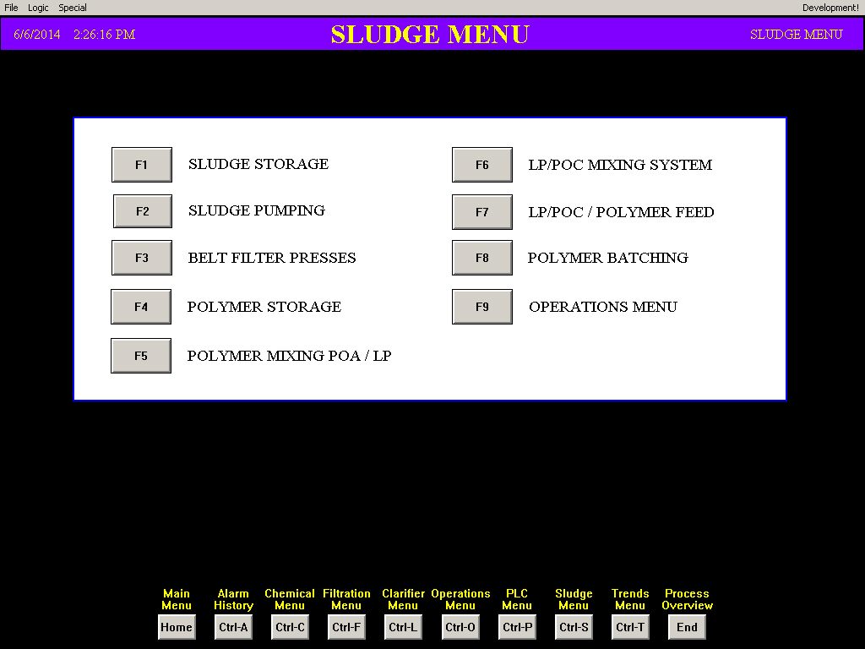
SLUDGE PRESS OPERATIONS MAIN MENU

Slide 23
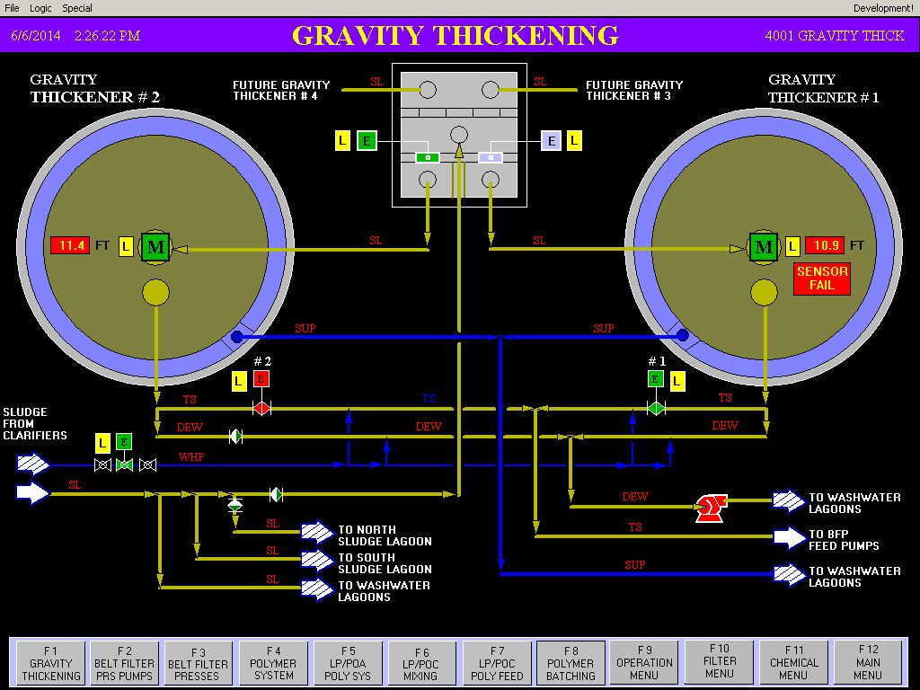
SLUDGE THICKENERS

Slide 24
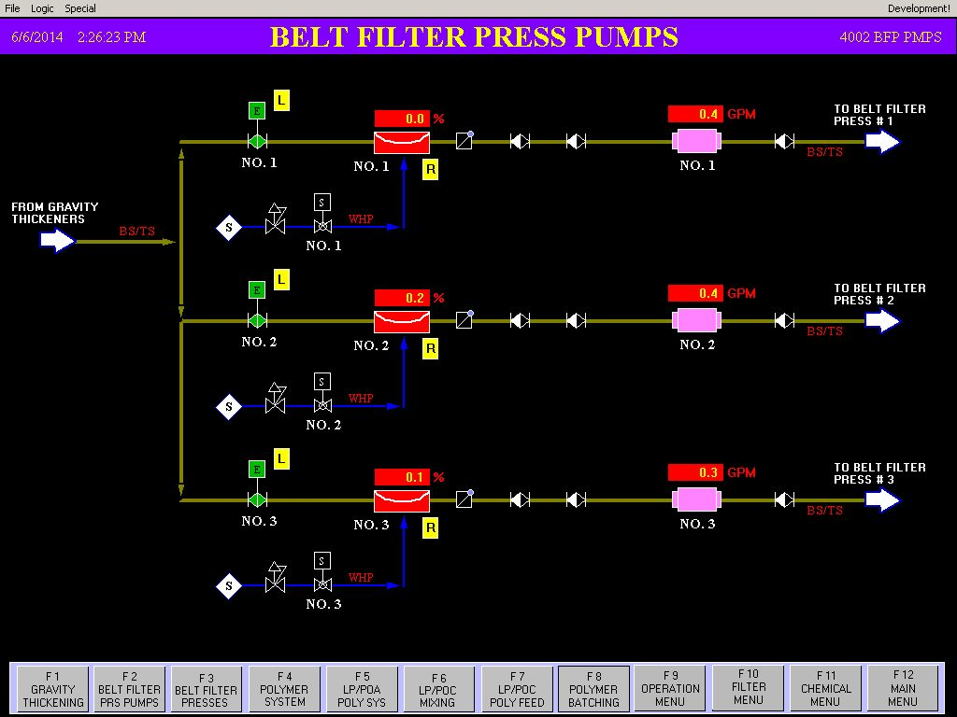
SLUDGE BELT FITER PRESS PUMPS

Slide 25
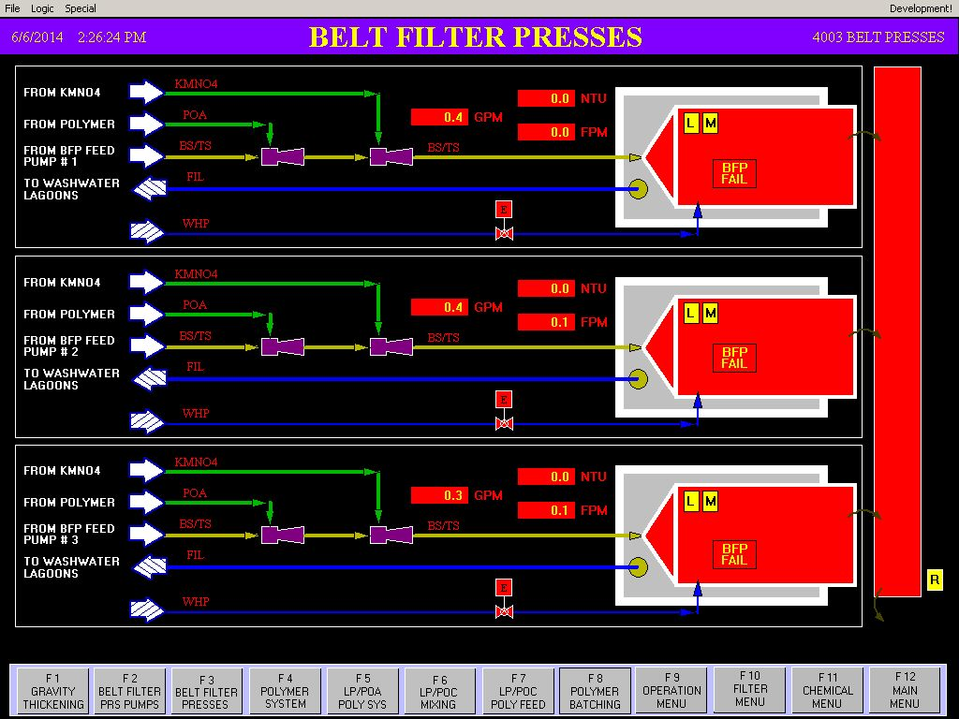
SLUDGE BELT FILTER PRESS

Slide 26
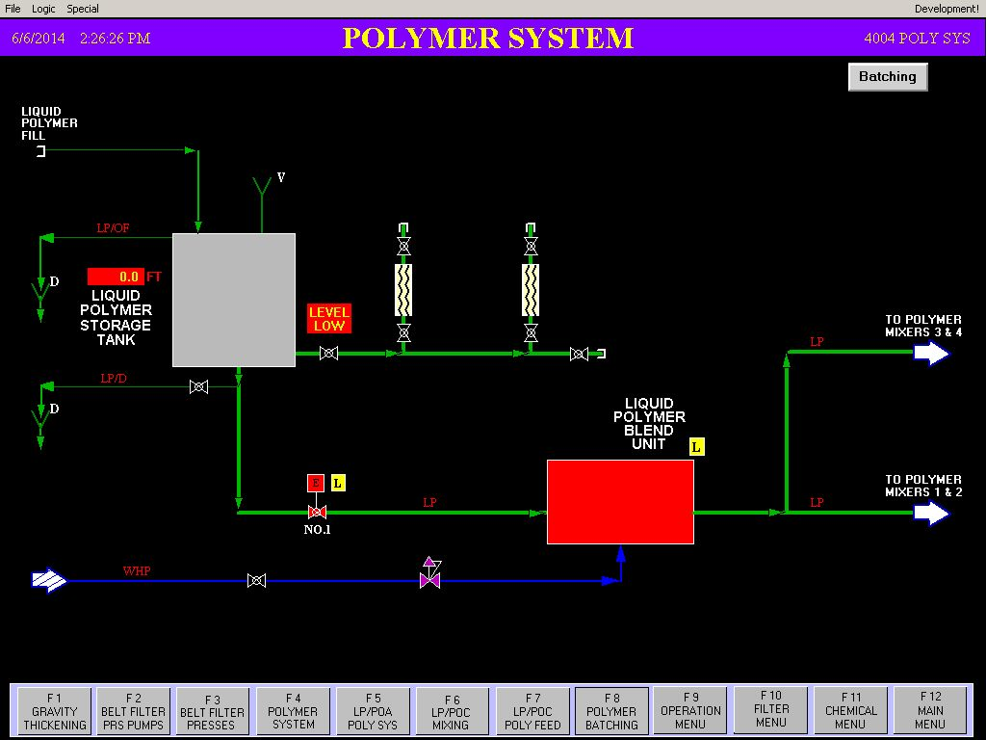
SLUDGE POLYMER SYSTEM

Slide 27
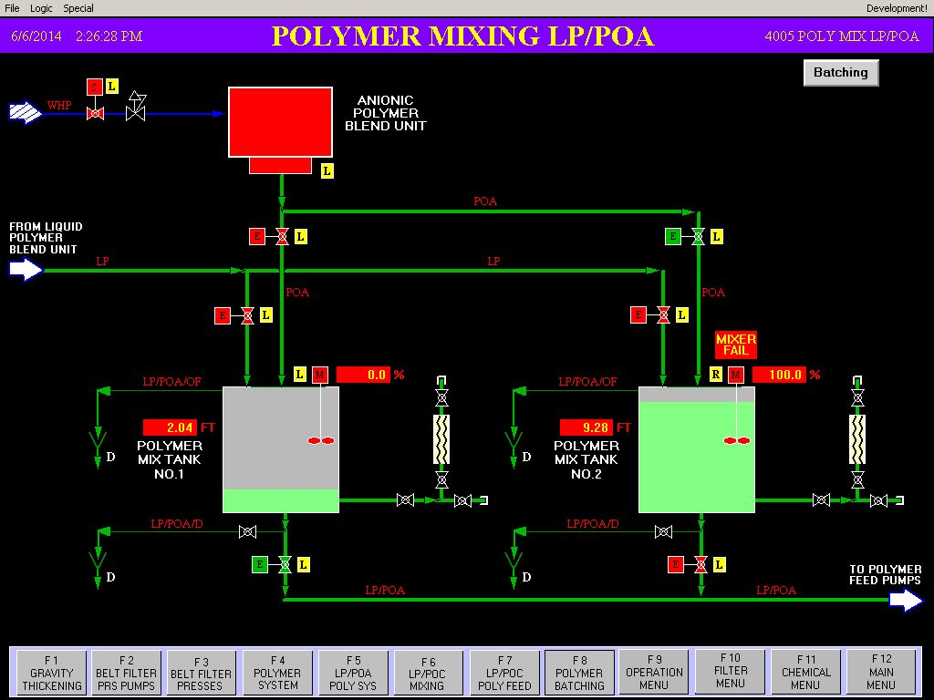
SLUDGE POLYMER MIXING LP/POA

Slide 28
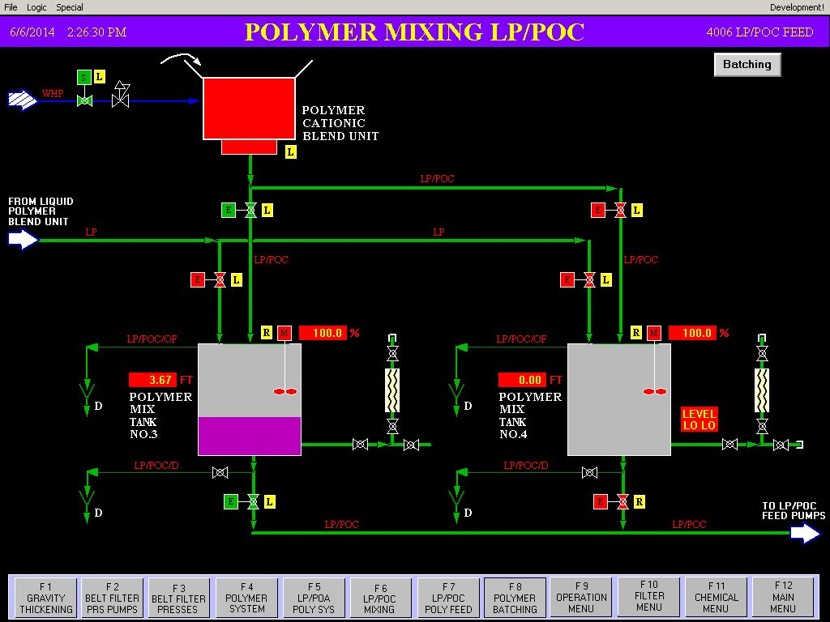
SLUDGE POLYMER MIXING LP/POC

Slide 29
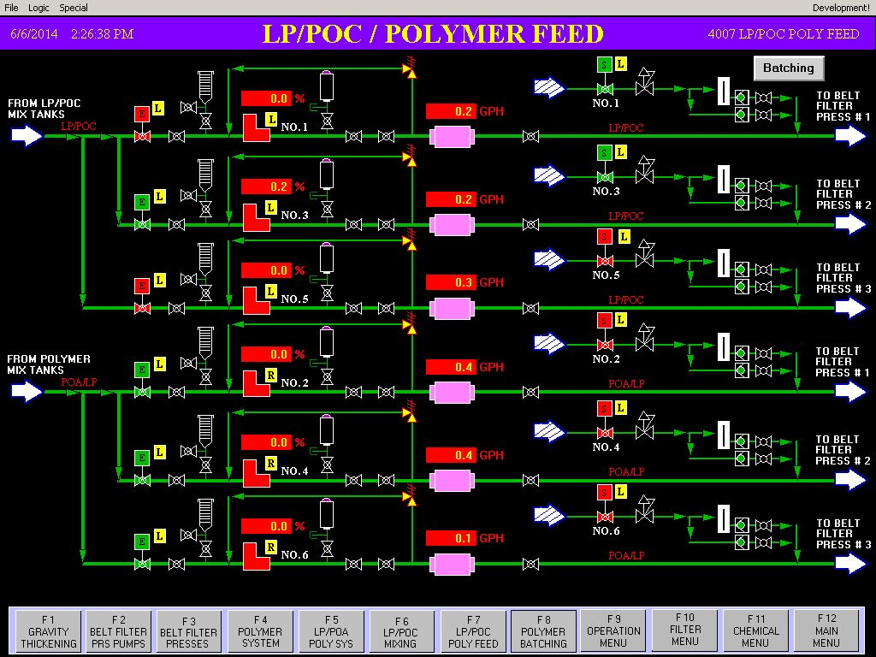
SLUDGE LP/POC/POLYMER FEED

Slide 30
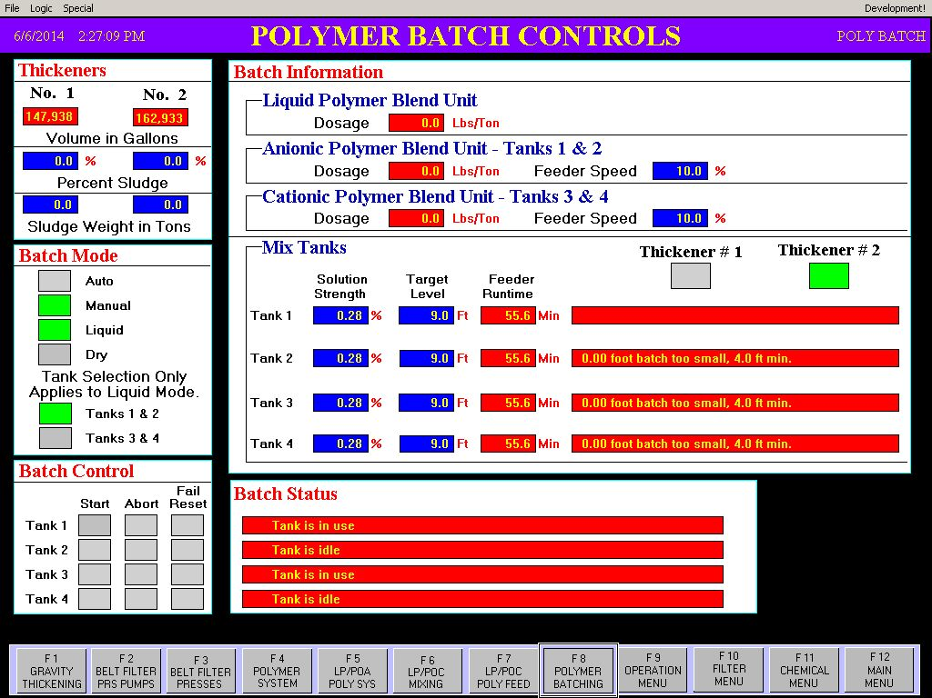
SLUDGE POLYMER BATCH CONTROLS

Slide 31
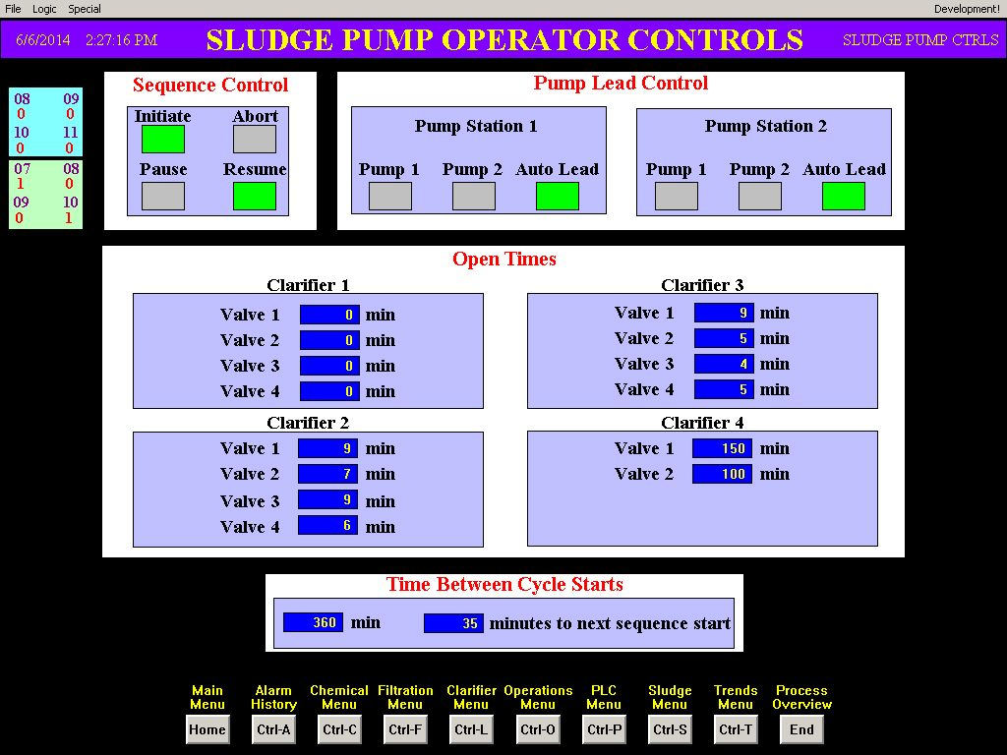
SLUDGE PUMP STATION OPERATOR CONTROLS

Slide 32
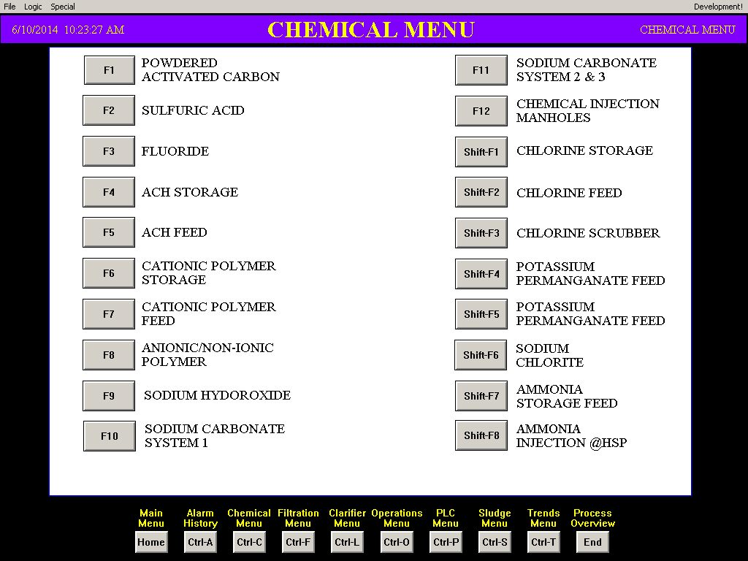
CHEMICAL MAIN MENU

Slide 33
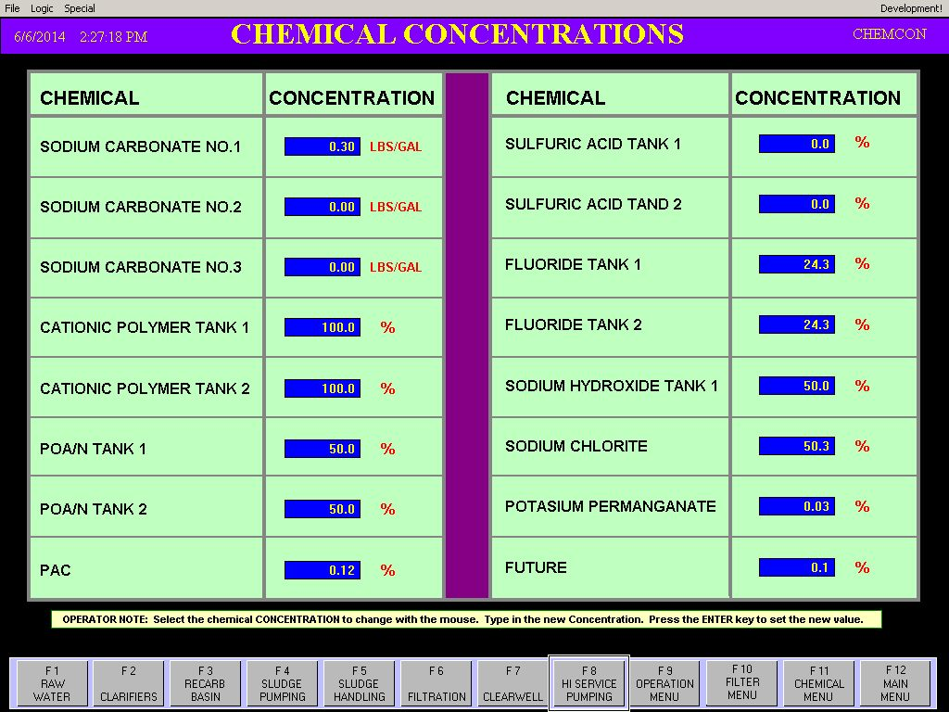
CHEMICAL CONCENTRATIONS

Slide 34
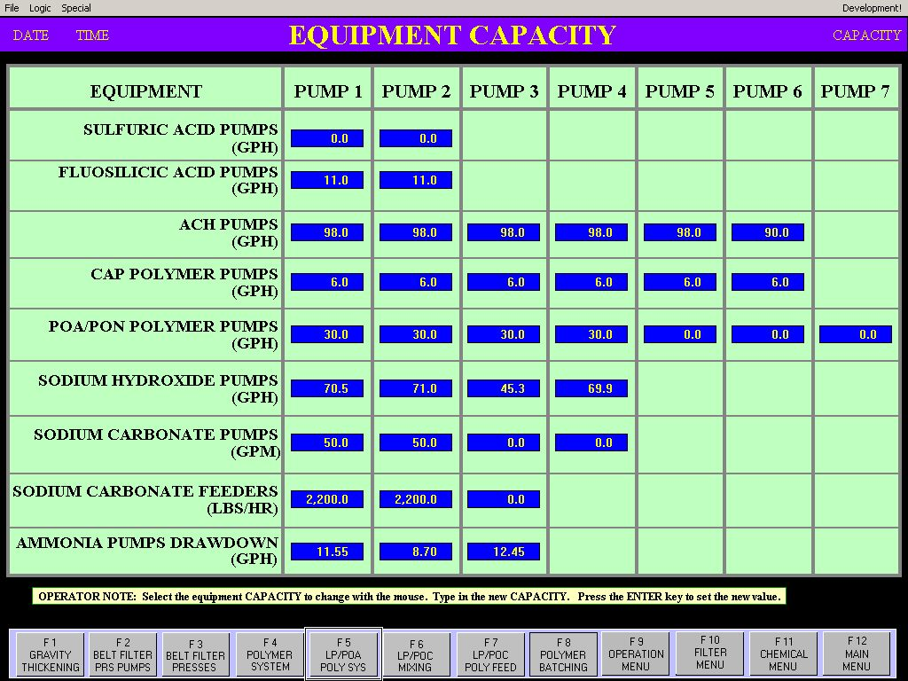
CHEMICAL PUMP EQUIPMENT CAPACITY

Slide 35
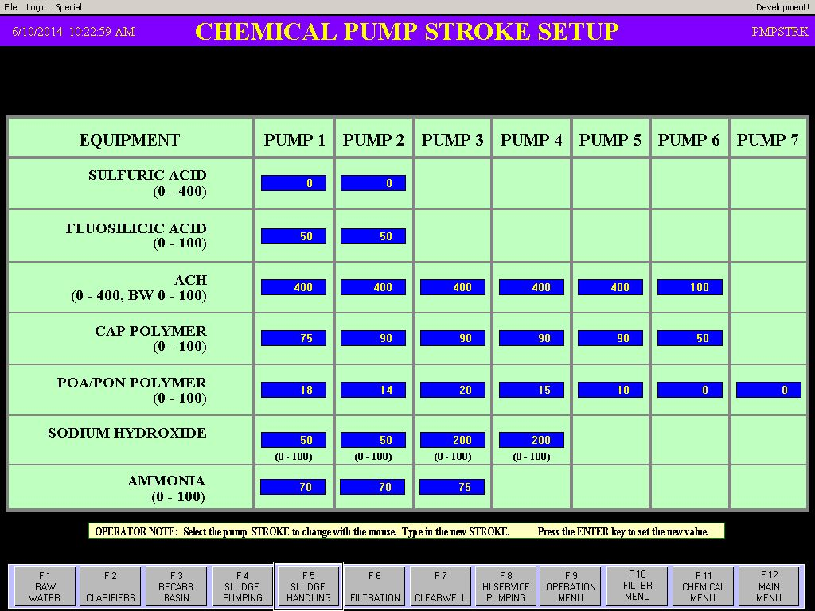
CHEMICAL PUMP STROKE SETTINGS

Slide 36
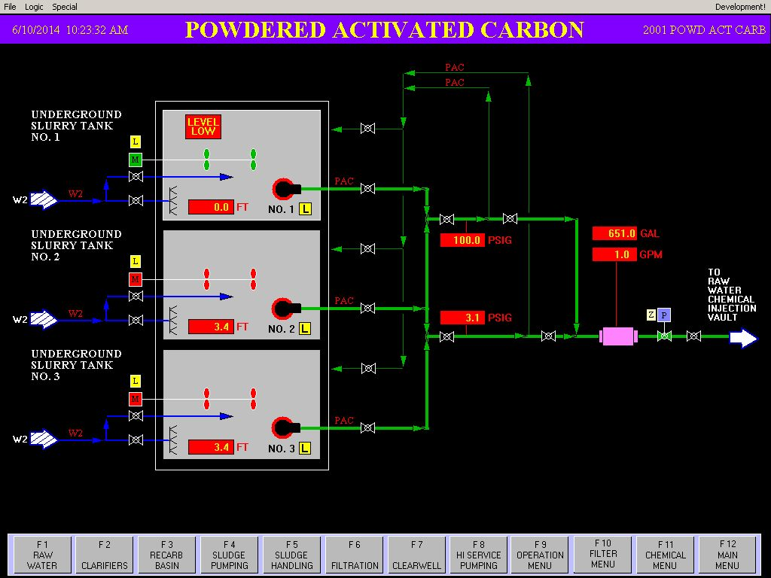
POWDERED ACTIVATED CARBON

Slide 37
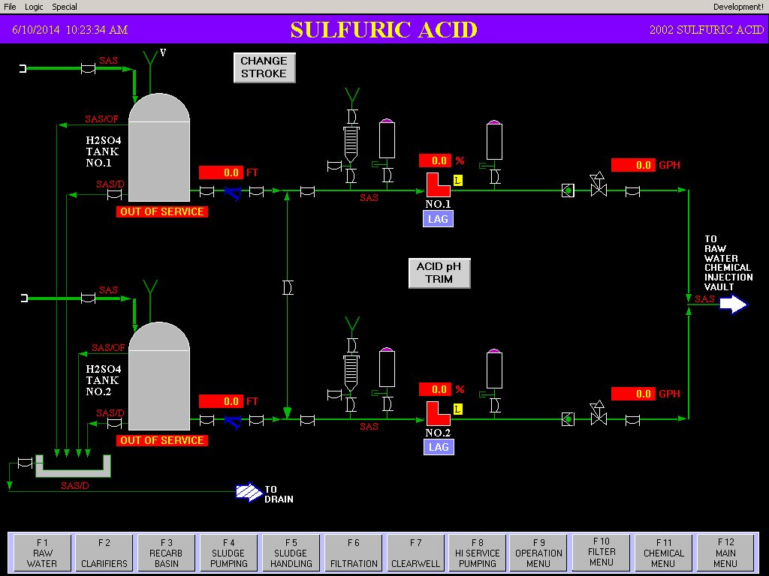
SULFURIC ACID

Slide 38
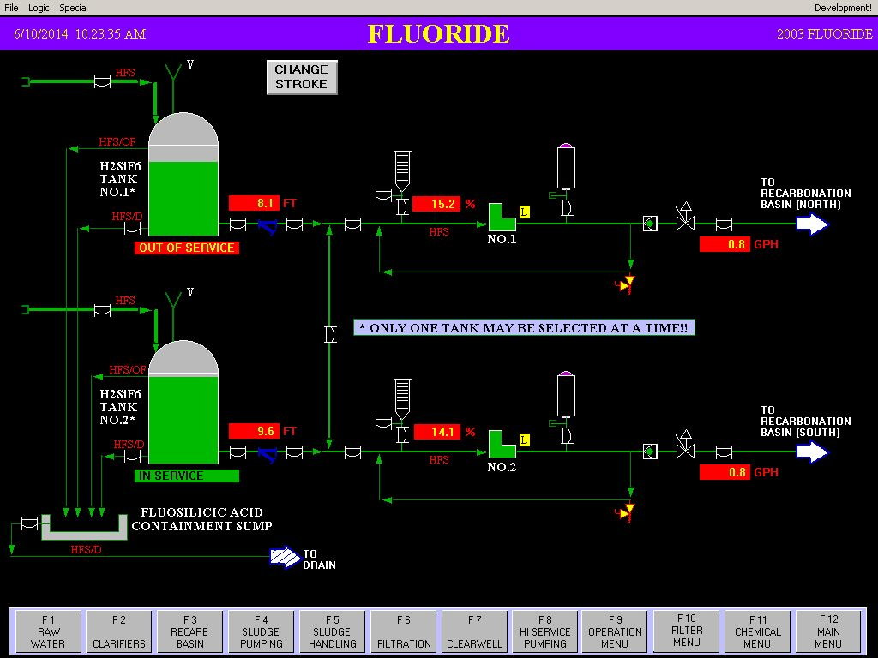
FLORIDE

Slide 39
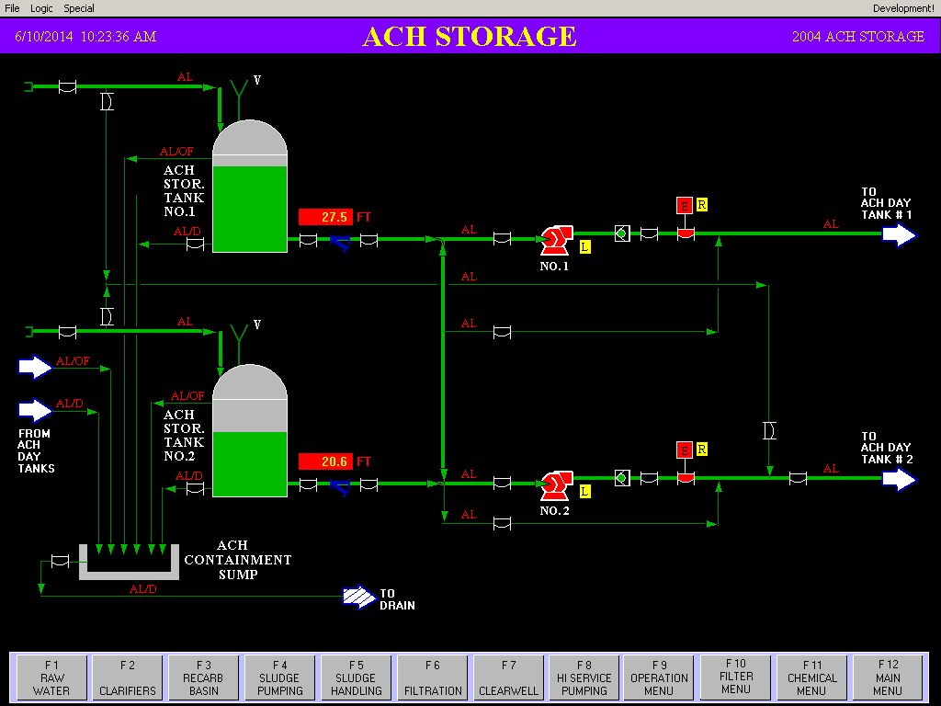
ACH STORAGE

Slide 40
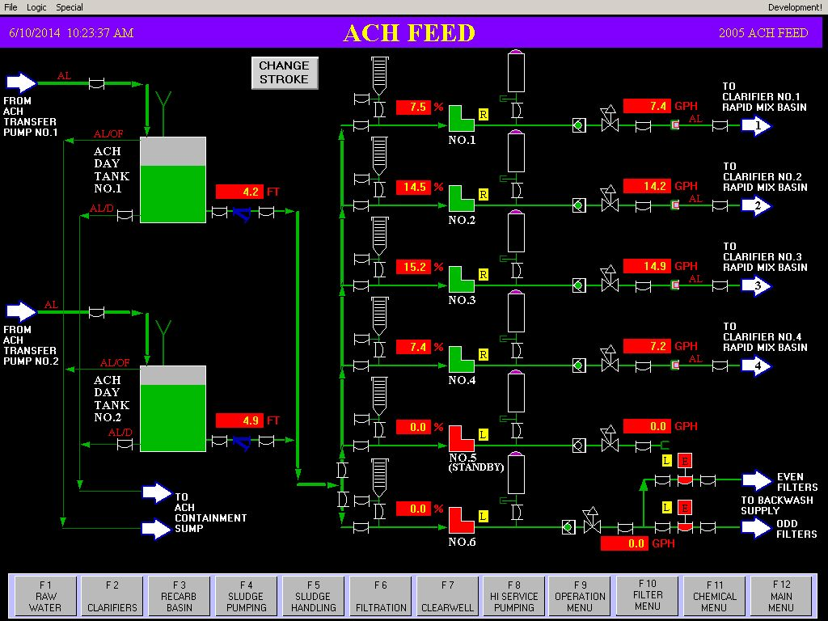
ACH DAY TANKS AND FEED PUMPS

Slide 41
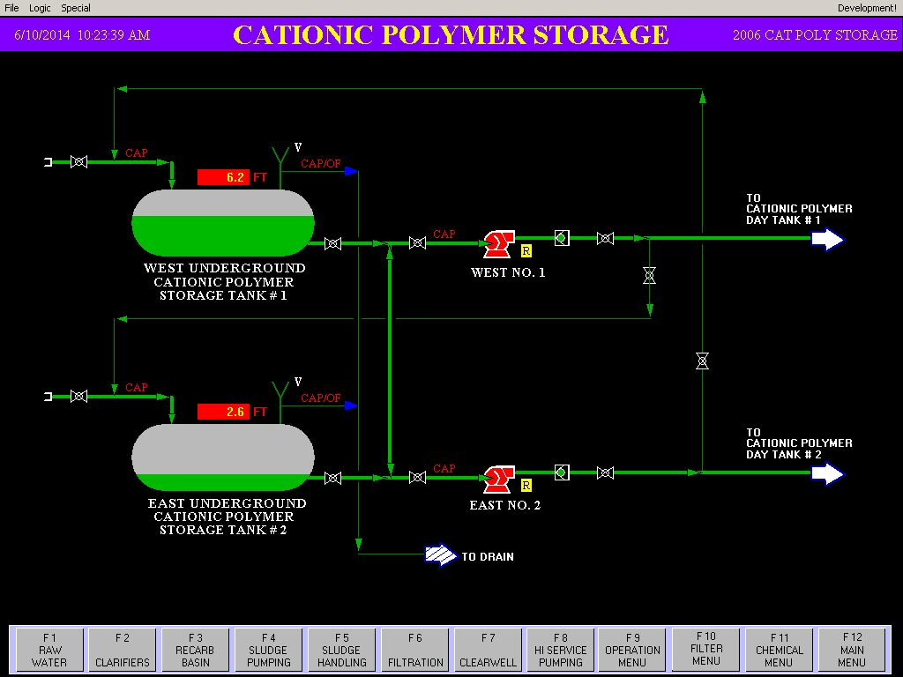
CATIONIC POLYMER STORAGE

Slide 42
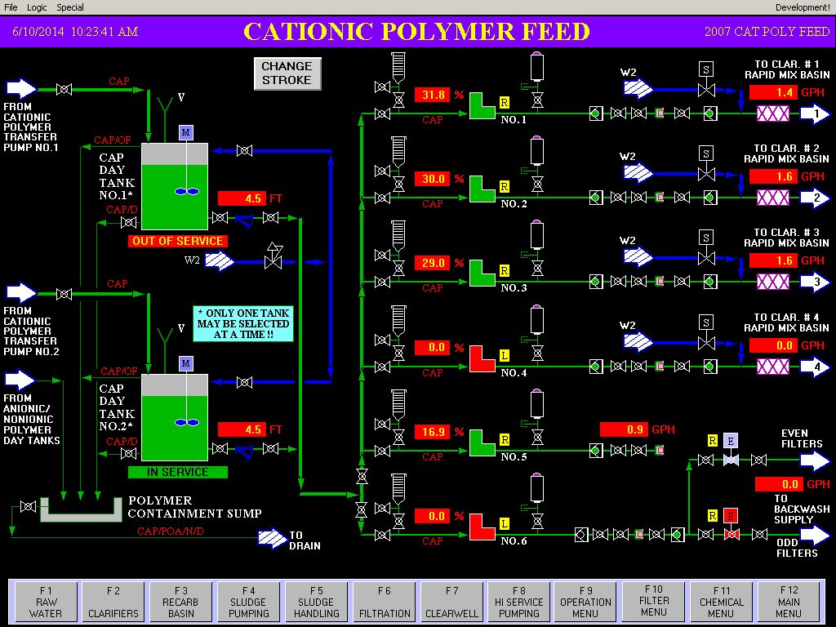
CATIONIC POLYMER DAY TANKS AND FEED PUMPS

Slide 43
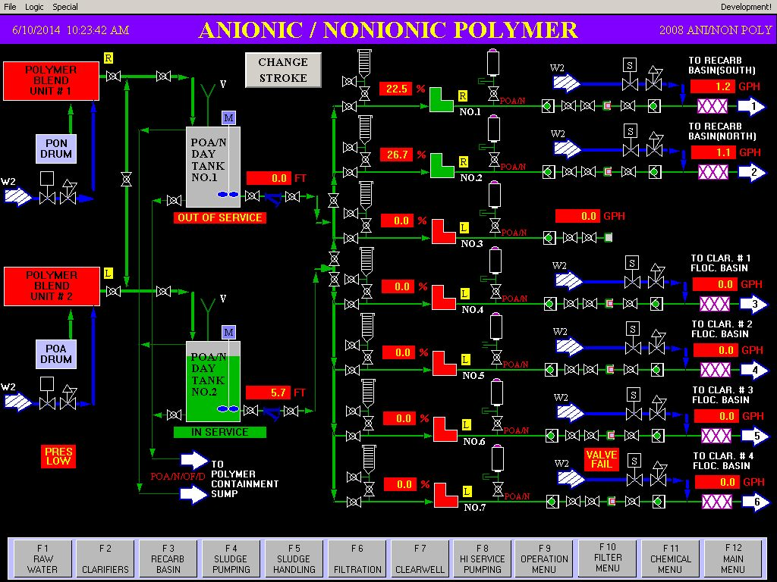
ANIONIC/NONIONIC POLYMER DAY TANKS AND FEED PUMPS

Slide 44
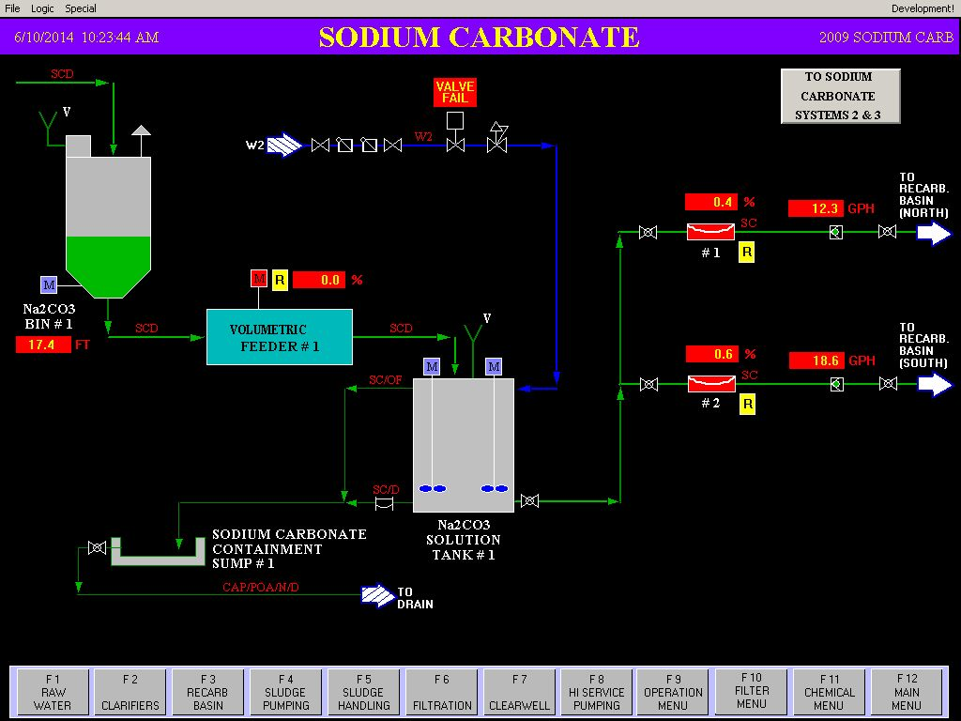
SODIUM CARBONATE 1

Slide 45
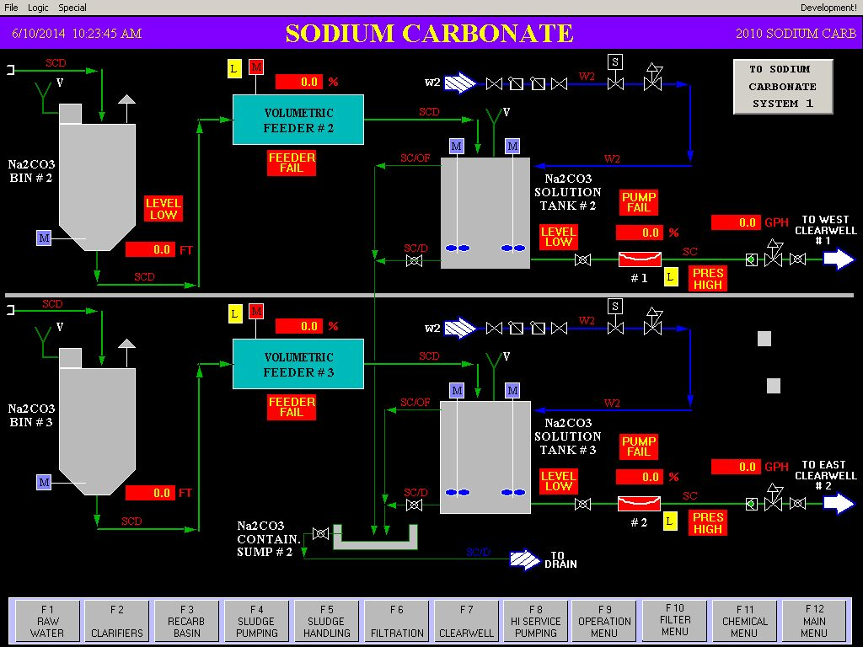
SODIUM CARBONATE 2

Slide 46
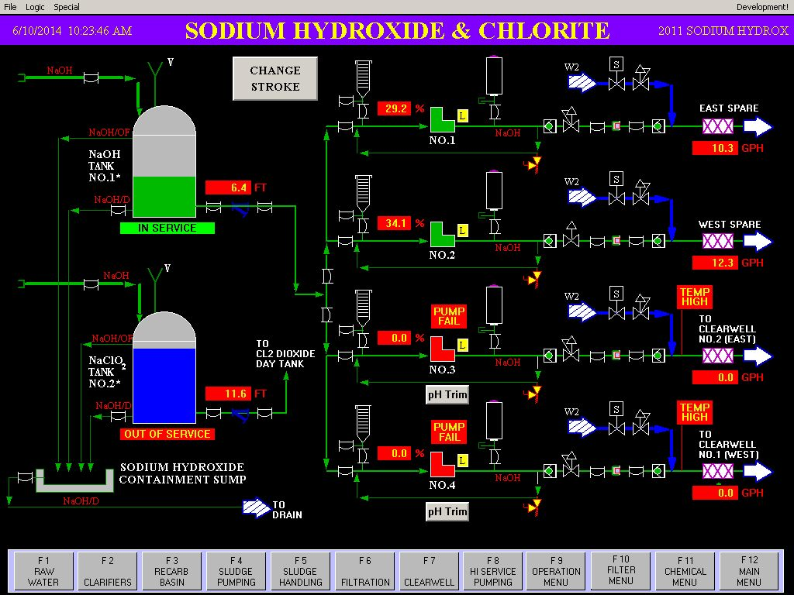
SODIUM HYDROXIDE AND CHLORITE

Slide 47
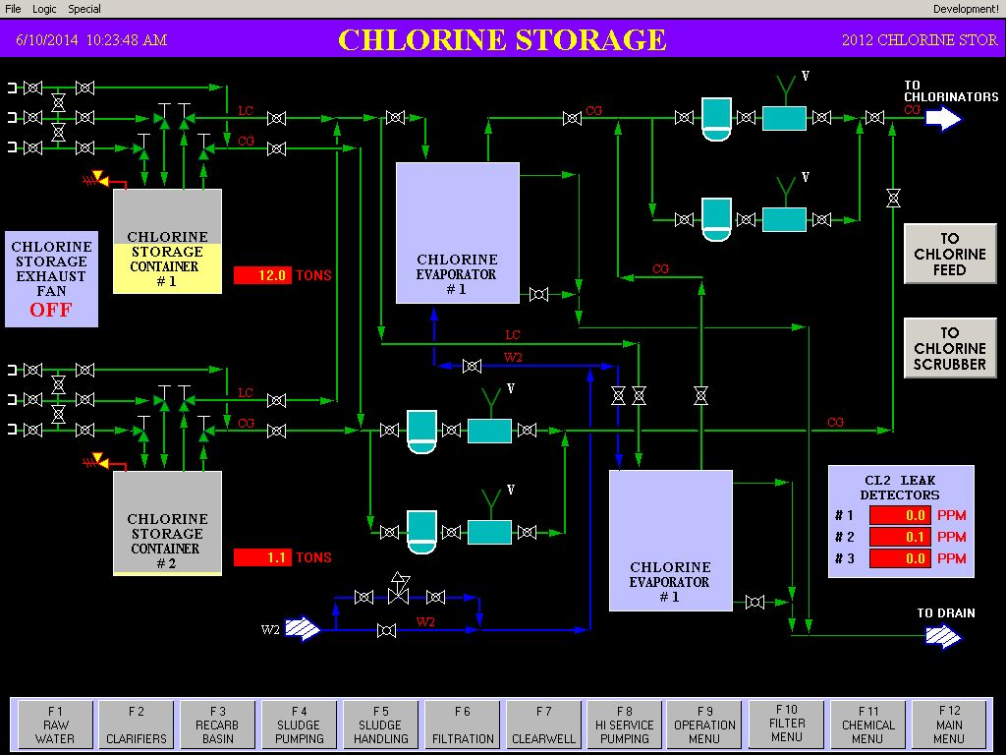
CHLORINE STORAGE

Slide 48
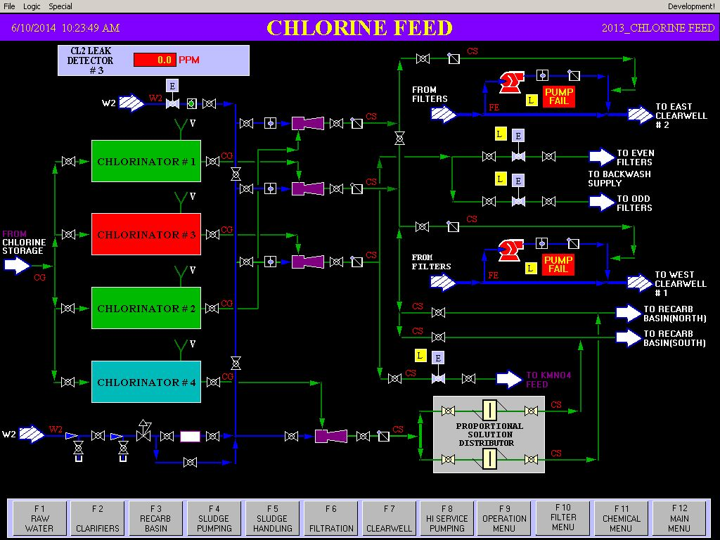
CHLORINE FEED

Slide 49
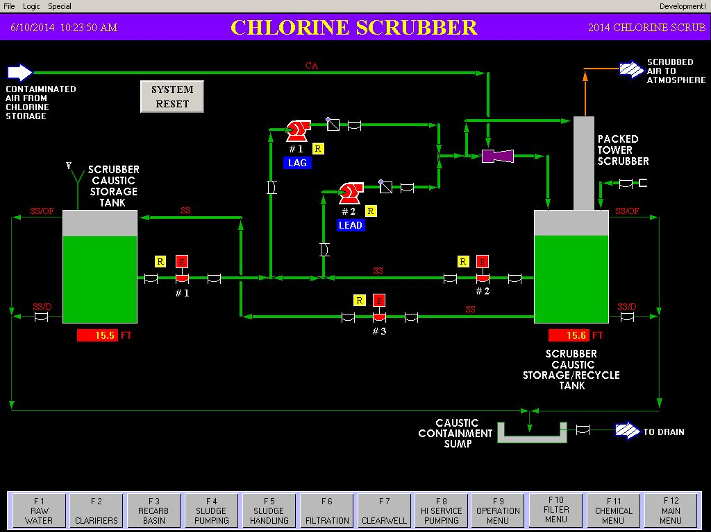
CHLORINE SCRUBBER

Slide 50
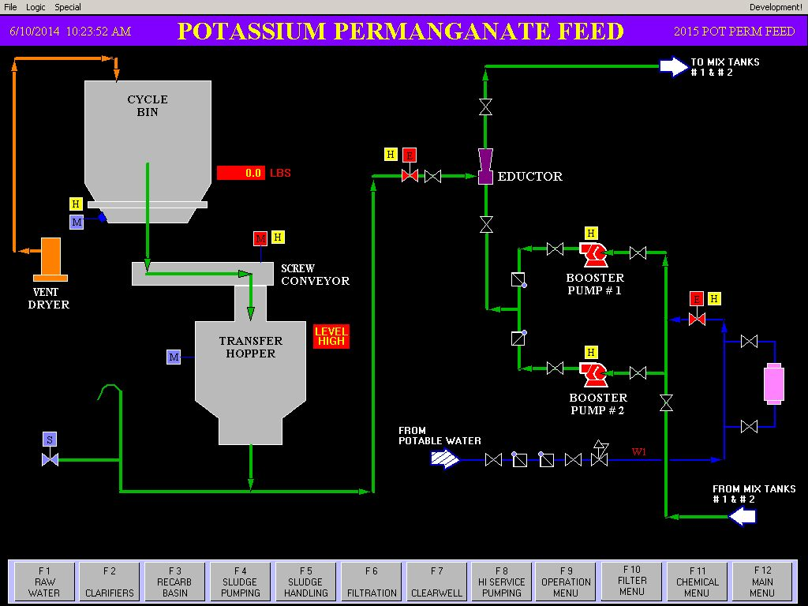
POTASSIUM PERMANGANATE FEED 1

Slide 51
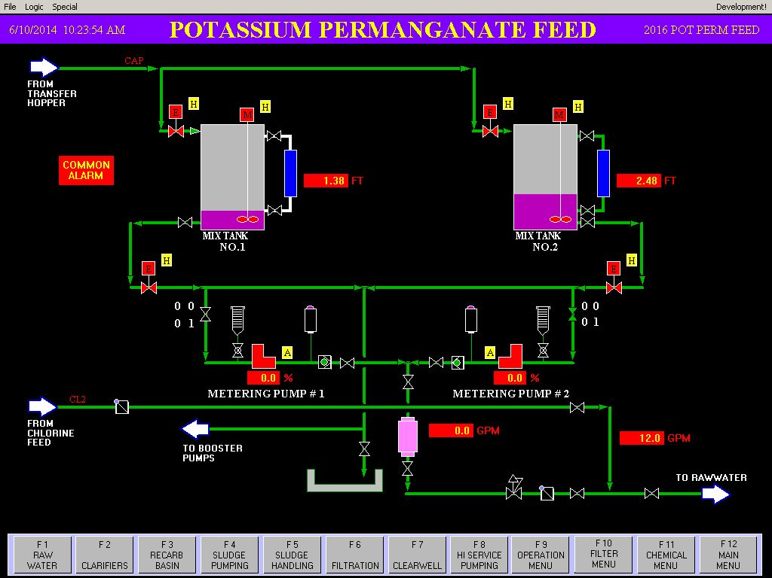
POTASSIUM PERMANGANATE FEED 2

Slide 52
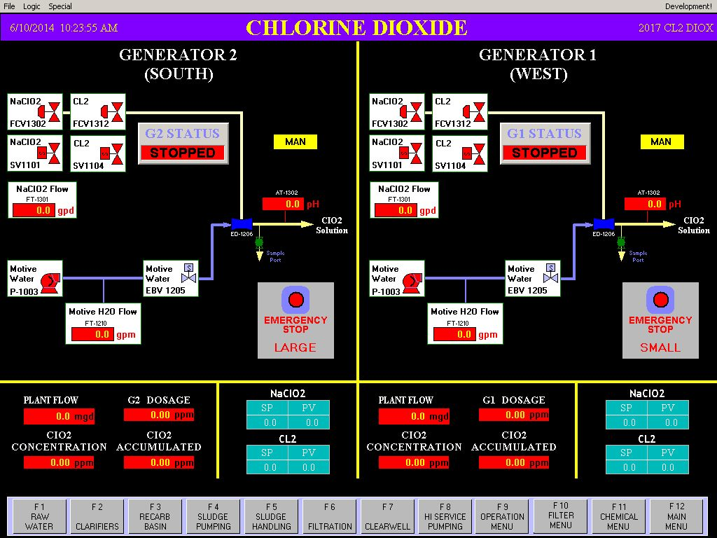
CHLORINE DIOXIDE 1

Slide 53

CHLORINE DIOXIDE 2

Slide 54

AMMONIA STORAGE & FEED INJECTORS

Slide 55

AMMONIA INJECTION @ HIGH SERVICE PUMP STATION

Slide 56

MAIN FILTER MENU

Slide 57

FILTER SETPOINT INPUT SCREEN

Slide 58

FILTER 1

Slide 59

FILTER 2

Slide 60

FILTER 3

Slide 61

FILTER 4

Slide 62

FILTER 5

Slide 63

FILTER 6

Slide 64

FILTER 7

Slide 65

FILTER 8

Slide 66

FILTER 9

Slide 67

FILTER 10

Slide 68

FILTER 11

Slide 69

FILTER 12

Slide 70

AIR SCOUR SYSTEM

Slide 71

FILTER WASHWATER TOWERS AND PUMPS

Slide 72

FILTER RECOVERED WATER PUMP STATION

Slide 73

OPERATIONS MENU

Slide 74

PROCESS STATUS REPORT PAGE 1

Slide 75

PROCESS STATUS REPORT PAGE 2

Slide 76

PROCESS STATUS REPORT PAGE 3

Slide 77

PROCESS STATUS REPORT PAGE 4

Slide 78

PROCESS STATUS REPORT PAGE 5

Slide 79

PROCESS STATUS REPORT PAGE 6

Slide 80

PROCESS STATUS REPORT PAGE 7

Slide 81

PROCESS STATUS REPORT PAGE 8

Slide 82

PROCESS STATUS REPORT PAGE 9

Slide 83

PLC INFORATION MENU

Slide 84

PLC HEART-BEAT DIAGNOSTIC DISPLAY

Slide 85

FK1000 PLC

Slide 86

FK2000 PLC

Slide 87

FK3000 PLC

Slide 88

FK4000 PLC

Slide 89

FK7000 PLC

Slide 90

FK8000 PLC

Slide 91

FK9000 PLC

Slide 92

FK10000 PLC

Slide 93

ALARM POP-UP DISPLAY OF CURRENT ALARMS

Slide 94

SYSTEM ALARM SUMMARY DISPLAY

Slide 95

SYSTEM ALARM HISTORY DISPLAY

Slide 96

TRENDS MENU

Slide 97

TREND 1

Slide 98

TREND 2

Slide 99

TREND 3

Slide 100

TREND 4

Slide 101

TREND 6

Slide 102

TREND 6

Slide 103

TREND 8

Slide 104

TREND 9

Slide 105

TREND 10

Slide 106

TREND 11

Slide 107

TREND 12

Slide 108

TREND 13

Slide 109

TREND 14

Slide 110

TREND 15

Slide 111

TREND 16

Slide 112

TREND 17

Slide 113

TREND 18

Slide 114

TREND 19

Slide 115

TREND 20

Slide 116

TREND 21

Slide 117

TREND 22

Slide 118

TREND 23

Slide 119

TREND 24

Slide 120

TREND 25

Slide 121

TREND 26

Slide 122

TREND 27

Slide 123

TREND 28

Slide 124

TREND 29

Slide 125

TREND 30

Slide 126

TREND 31

Slide 127

TREND 32

Slide 128

TREND 33

Slide 129

TREND 34

Slide 130

TREND 35

Slide 131

TREND 36

Slide 132

TREND 37

Slide 133

TREND 38

Slide 134

TREND 39

Slide 135

TREND 40

Slide 136

TREND 41

Slide 137

TREND 42

Slide 138

TREND 43

Slide 139

TREND 44

Slide 140

TREND 46

Slide 141

TREND 47

Slide 142

TREND 48

Slide 143

TREND 49

Slide 144

TREND 50

Slide 145

TREND 51

Slide 146

TREND 52

Slide 147

TREND 53

Slide 148

TREND 54

Slide 149

TREND 55

Slide 150

TREND 56

Slide 151

TREND 57

Slide 152

TREND 58

Slide 153

TREND 59

Slide 154

TREND 60

Slide 155

TREND 61

Slide 156

TREND 62

Slide 157

TREND 63

Slide 158

TREND 64

Slide 159

TREND 65

Slide 160

TREND 66

Slide 161

TREND 67

Slide 162

TREND 68

Slide 163

TREND 69

Slide 164

DATA RETRIEVAL FOR MANAGEMENT
Not generally used by operations, but could / should be.

Slide 165

HIGH SERVICE PUMP CONTROL OPERATION POP-UP

Slide 166

Rough drawing of existing Fiber network in plant
The remaining slides are of typical pop-ups used in the AB Jewell SCADA HMI.

Slide 167

TYPICAL PUMP START STOP ONLY POP-UP

Slide 168

TYPICAL TANK SELECTION POP-UP

Slide 169

TYPICAL FEED PUMP START/STOP WITH LEAD & PID OPTIONS

Slide 170

TYPICAL FEED PUMP POP-UP WITH STANDBY AND PID WINDOW OPTIONS

Slide 171

TYPICAL OPERATOR SELECTION POP-UP DISPLAY

Slide 172

TYPICAL PID DISPLAY POP-UP WITH SET POINT AND AUTO/MANUAL INPUT OPTIONS

Slide 173

TYPICAL PUMP START/STOP WITH AUTO/MANUAL OPTIONS

Slide 174

TYPICAL FEED PUMP POP-UP WITH SPEED OPTION

Slide 175

TYPICAL OPEN/CLOSE CONTROL FOR VALVES

Slide 176

TYPICAL VALVE OPEN/CLOSE POP-UP WITH AUTO/MANUAL OPTIONS

Slide 177

TYPICAL POP-UP WITH OPERATOR LEAD CONTROL OPTION

Slide 178

TYPICAL LEAD SELECTION POP-UP

Slide 179

TYPICAL PID POP-UP WITH AUTO/MANUAL OPTION AND SET POINT INPUT

Slide 180

CHLORINE DIOXIDE EMERGENCY SHUTDOWN POP-UP

Slide 181

RAW WATER PUMPING SCHEME OPERATION POP-UP

Slide 182

AMMONIA STORAGE INJECTOR OPERATION POP-UP

Slide 183

RAW WATER PUMP OPERTIONS POP-UP

Slide 184

RAW WATER LEAD SELECT POP-UP

Slide 185

RAW WATER JUNCTION CHAMBER VALVE OPERATIONS

Slide 186

TYPICAL CLARIFIER INPUT VALVE CONTROL POP-UP WITH SHARED/FIXED AND AUTO/MANUAL OPTIONS

Slide 187

CLARIFIER INPUT PID CONTROLS

Slide 188

TYPICAL MIXER START/STOP POPUP

Slide 189

SLUDGE PUMP STATION VALVE OPEN/CLOSE WITH AUTO/MANUAL OPTION AND ACCESS TO PUMPING SEQUENCE SCREEN

Slide 190
End of slide show
Keyboard Operations:
ESC – Back to the Menu where the screen can be called from.
TAB – Back to the previous screen – 15 previous screens are remembered.
INSERT – Opens the Alarm Summary Screen
DELETE – Acknowledges the most current alarm.
PAGE UP – Cycles through a group of Windows from the existing window.
PAGE DOWN – Cycles though the group of Windows in opposite direction.
HOME – Opens the Plant Overview Screen.
END – Opens the second Plant Overview Screen.
Cntrl + (letter) – Opens selected Menu Screen. Ie. – Cntrl + C opens the Chemical Menu. Cntrl + A opens the Alarm Summary Screen.
F1 – F12 can open windows listed in Bottom Menu bar when on any given screen. Sometimes the Shift key has to be pushed in addition to the ‘F’ key. Indicated on the screen displayed.

